Slide 1


Slide 2
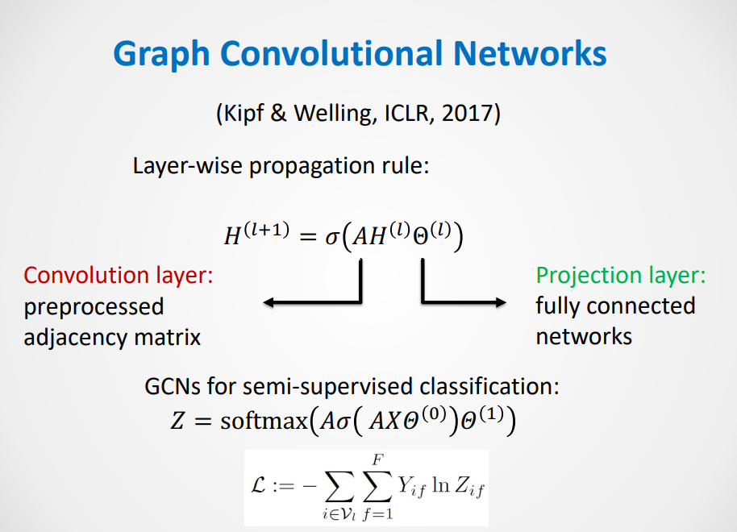

Slide 3
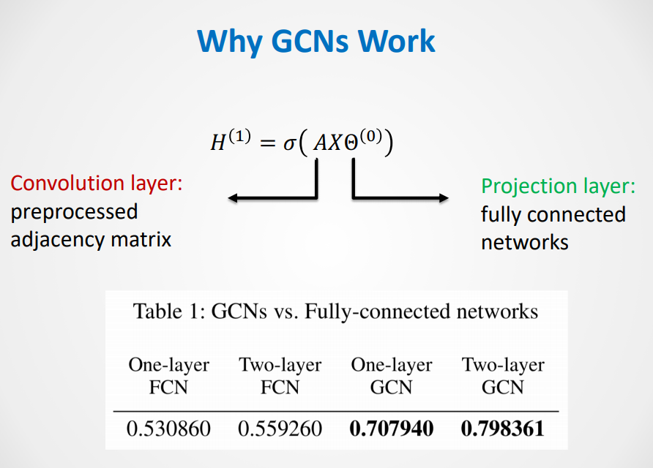

Slide 4
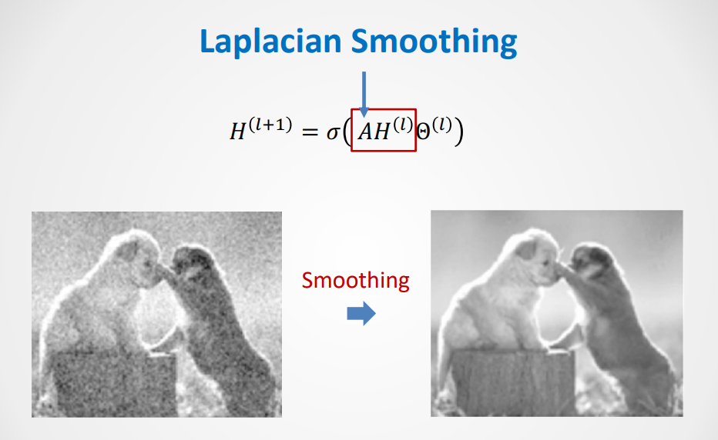

Slide 5


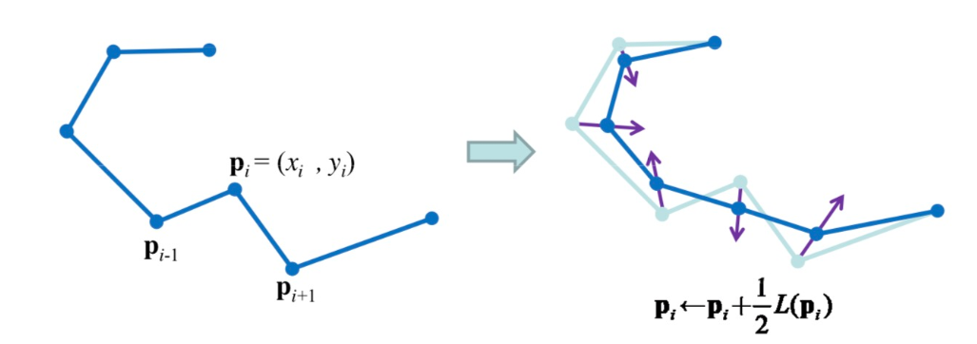
Laplacian Smoothing
How to smooth a curve, which contains a series of discrete points, pi?
move each point to the weighted mean of its neighbors by

Slide 6
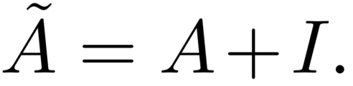
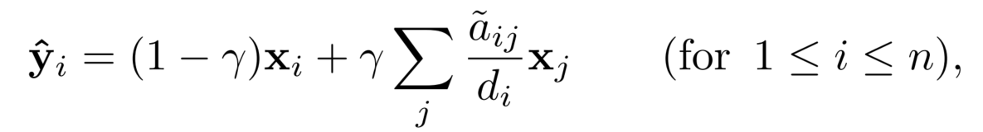



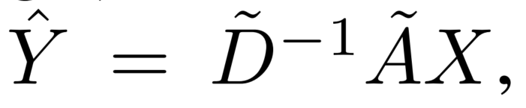


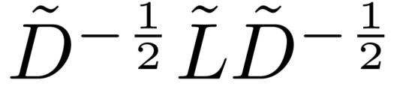

The Laplacian smoothing in each channel
Write the Laplacian smoothing in matrix form:
replace the normalized Laplacian with the symmetrically normalized Laplacian

Slide 7
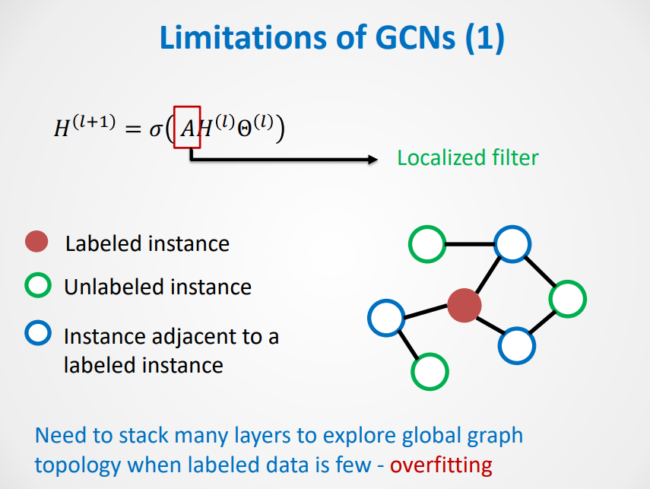

Slide 8
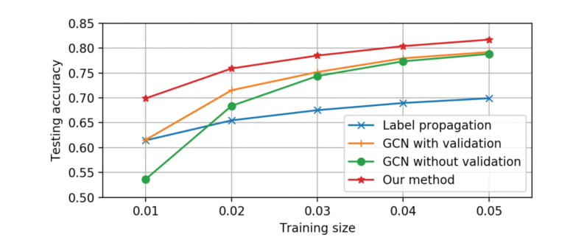
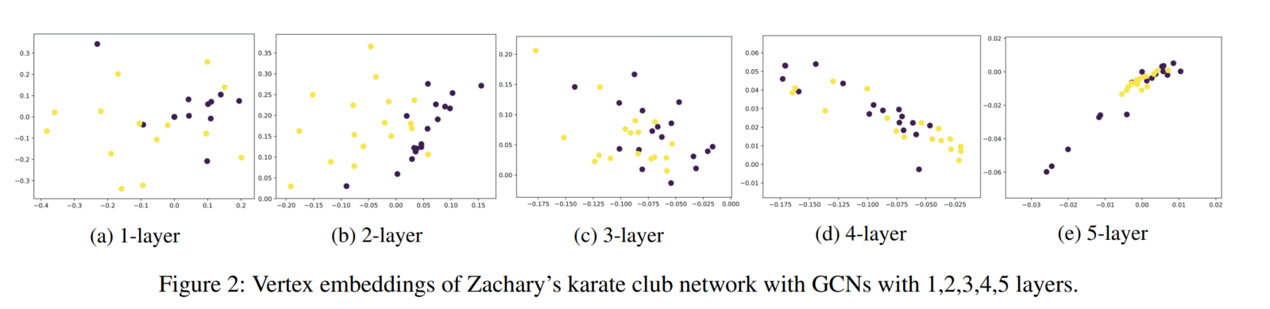

Slide 9
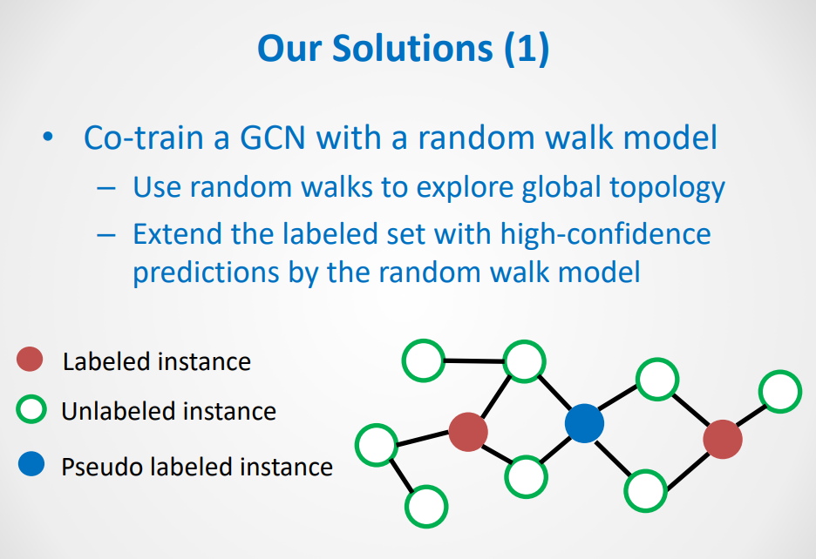

Slide 10
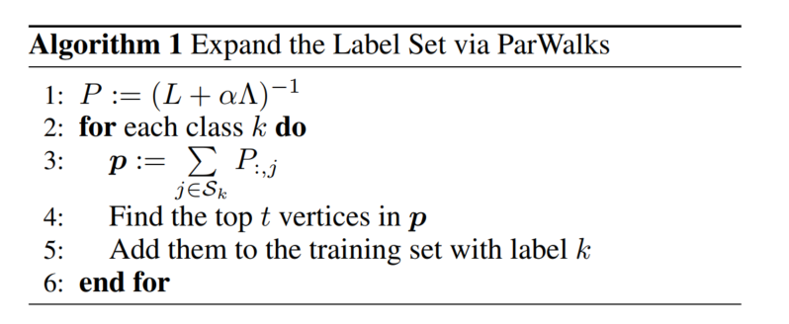
Pi;j is the probability of a random walk from vertex i being absorbed by vertex j,
which represents how likely i and j belong to the same class.

Slide 11
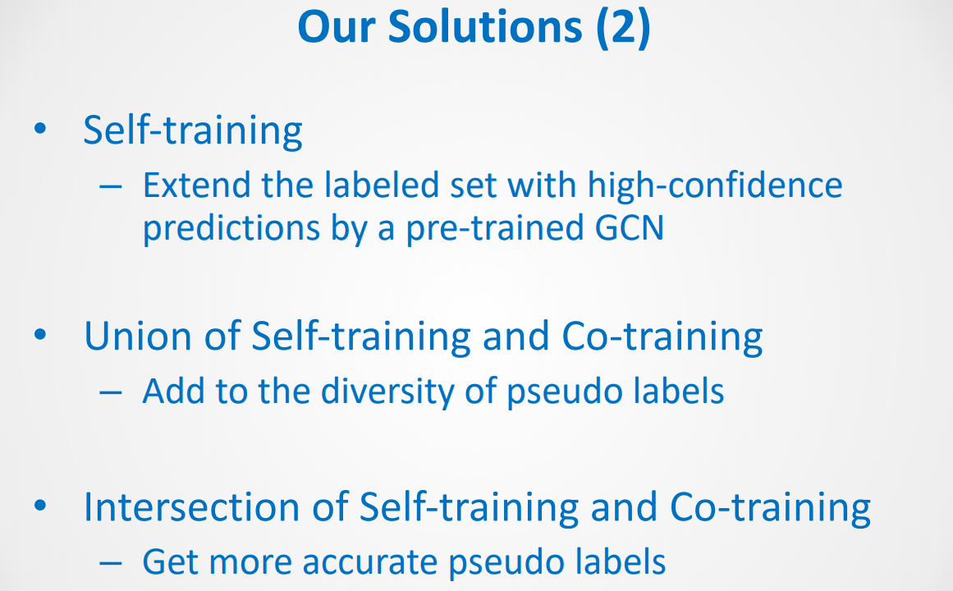

Slide 12
